Slide 1
Network Layer
Subnet

Slide 2
Network Layer
All the hosts in a network must have the same network number. This property of IP addressing can cause problems as networks grow.
For example, consider a university that started out with one class B network used by the Computer Science Dept. For the computers on its Ethernet. A year later, the Electrical Engineering Dept. wanted to get on the Internet, so they bought a repeater to extend the CS Ethernet to their building. As time went on, many other departments acquired computers and the limit of Ethernet was quickly reached.
The solution is to allow a network to be split into several parts for internal use but still act like a single network to the outside world.

Slide 3
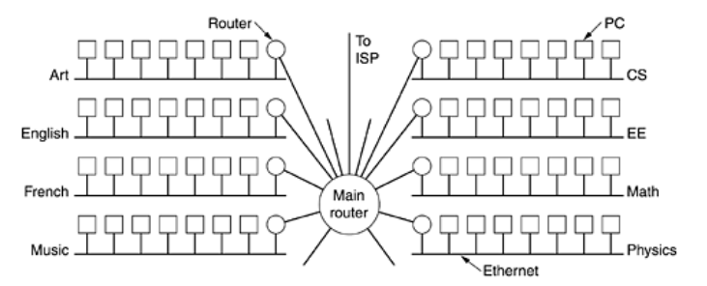
Network Layer

Slide 4
Network Layer
To implement subnetting, the main router needs a subnet mask that indicates the split between network + subnet number and host.
Subnet masks are also written in dotted decimal notation, with the addition of a slash followed by the number of bits in the network + subnet part.
The subnet mask can be written as 255.255.252.0. An alternative notation is /22 to indicate that the subnet mask is 22 bits long.
To see how subnets work, it is necessary to explain how IP packets are processed at a router. Each router has a table listing some number of (network, 0) IP addresses and some number of (this-network, host) IP addresses.
The first kind tells how to get to distant networks. The second kind tells how to get to local hosts. Associated with each table is the network interface to use to reach the destination, and certain other information.

Slide 5
Network Layer
When an IP packet arrives, its destination address is looked up in the routing table. If the packet is for a distant network, it is forwarded to the next router on the interface given in the table. If it is a local host (e.g., on the router's LAN), it is sent directly to the destination. If the network is not present, the packet is forwarded to a default router with more extensive tables. This algorithm means that each router only has to keep track of other networks and local hosts, not (network, host).
When subnetting is introduced, the routing tables are changed, adding entries of the form (this-network, subnet, 0) and (this-network, this-subnet, host). Thus, a router on subnet k knows how to get to all the other subnets and also how to get to all the hosts on subnet k. It does not have to know the details about hosts on other subnets.
In fact, all that needs to be changed is to have each router do a Boolean AND with the network's subnet mask to get rid of the host number and look up the resulting address in its tables.

Slide 6
Network Layer
For example, a packet addressed to 130.50.15.6 and arriving at the main router is ANDed with the subnet mask 255.255.252.0/22 to give the address 130.50.12.0. This address is looked up in the routing tables to find out which output line to use to get to the router for subnet.
Subnetting thus reduces router table space by creating a three-level hierarchy consisting of network, subnet, and host.

Slide 7
Network Layer
CIDR—Classless InterDomain Routing
IP has been in heavy use for decades. It has worked extremely well, as demonstrated by the exponential growth of the Internet due to which it is running out of addresses.
In principle, over 2 billion addresses exist, but the practice of organizing the address space by classe wastes millions of them.
In particular, the real villain is the class B network. For most organizations, a class A network, with 16 million addresses is too big, and a class C network, with 256 addresses is too small. A class B network, with 65,536, is just right. In Internet folklore, this situation is known as the three bears problem.
In reality, a class B address is far too large for most organizations. Studies have shown that more than half of all class B networks have fewer than 50 hosts. Class C network would have done the job, but no doubt every organization that asked for a class B address thought that one day it would outgrow the 8-bit host field. In retrospect, it might have been better to have had class C networks use 10 bits instead of eight for the host number, allowing 1022 hosts per network.

Slide 8
Network Layer
CIDR—Classless InterDomain Routing
At the time the decision was made to create the three classes, the Internet was a research network connecting the major research universities in the U.S.
However, if the split had allocated 20 bits to the class B network number, another problem would have emerged: the routing table explosion. From the point of view of the routers, the IP address space is a two-level hierarchy, with network numbers and host numbers. Routers do not have to know about all the hosts, but they do have to know about all the networks. If half a million class C networks were in use, every router in the entire Internet would need a table with half a million entries, one per network, telling which line to use to get to that network.
A more serious problem is that the complexity of various algorithms relating to management of the tables grows faster than linear.
In addition, various routing algorithms require each router to transmit its tables periodicallyThe larger the tables, the more likely it is that some parts will get lost underway, leading to incomplete data at the other end and possibly routing instabilities.

Slide 9
Network Layer
CIDR—Classless InterDomain Routing
The solution that was Implemented is known as CIDR(Classless InterDomain Routing).
The basic idea behind CIDR is to allocate the remaining IP addresses in variable-sized blocks, without regard to the classes.
With CIDR, simple routing algorithm no longer works. Instead, each routing table entry is extended by giving it a 32-bit mask. Thus, there is now a single routing table for all networks consisting of an array of (IP address, subnet mask, outgoing line) triples.
When a packet comes in, its destination IP address is first extracted. Then the routing table is scanned entry by entry, masking the destination address and comparing it to the table entry looking for a match.

Slide 10
Network Layer
NAT—Network Address Translation
The number of home users and small businesses that want to use the Internet is ever increasing. In the beginning, a user was connected to the Internet with a dial-up line, which means that she was connected for a specific period of time.
An ISP with a block of addresses could dynamically assign an address to this user. An address was given to a user when it was needed. But the situation is different today. Home users and small businesses are increasing day by day.
A quick solution to this problem is called network address translation (NAT).
NAT enables a user to have a large set of addresses internally and one address, or a small set of addresses, externally. The traffic inside can use the large set; the traffic outside, the small set.

Slide 11
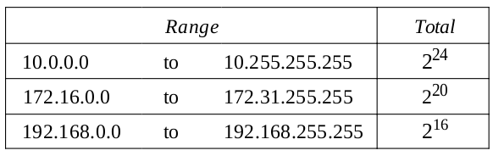
Network Layer
NAT—Network Address Translation
To separate the addresses used inside the home or business and the ones used for the Internet, the Internet authorities have reserved three sets of addresses as private addresses.
Any organization can use an address out of this set without permission from the Internet authorities. Everyone knows that these reserved addresses are for private networks. They are unique inside the organization, but they are not unique globally.
No router will forward a packet that has one of these addresses as the destination address.

Slide 12
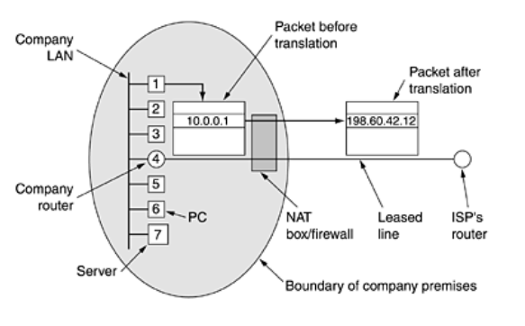
Network Layer
NAT—Network Address Translation
Within the company premises, every machine has a unique address of the form 10.x.y.z. However, when a packet leaves the company premises, it passes through a NAT box that converts the internal IP source address, 10.0.0.1 in the figure, to the company's true IP address, 198.60.42.12.

Slide 13
Network Layer
NAT—Network Address Translation
The NAT box is often combined in a single device with a firewall, which provides security by carefully controlling what goes into the company and what comes out.
Translating the source addresses for outgoing packets is straightforward. But how does the NAT router know the destination address for a packet coming from the Internet? There may be tens or hundreds of private IP addresses, each belonging to one specific host. The problem is solved if the NAT router has a translation table.
A translation table has only two columns: the private' address and the external address (destination address of the packet). When the router translates the source address of the outgoing packet, it also makes note of the destination address-where the packet is going. When the response comes back from the destination, the router uses the source address of the packet (as the external address) to find the private address of the packet.

Slide 14
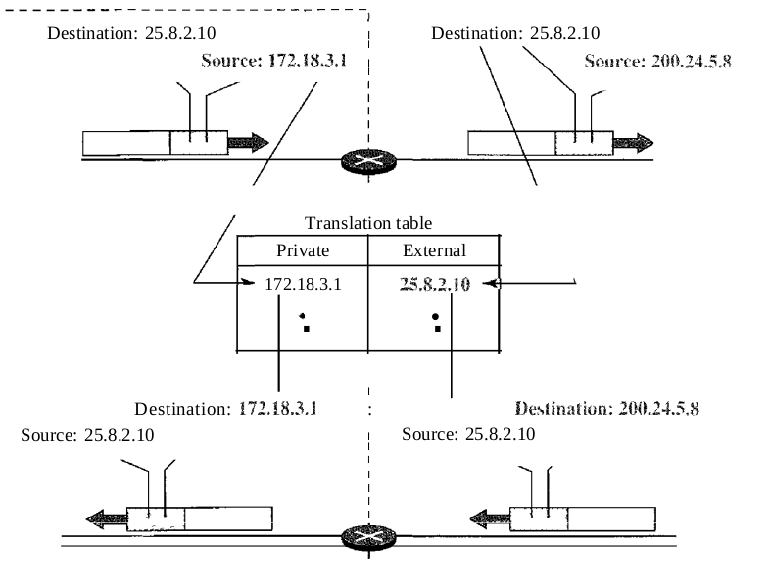
Network Layer
NAT—Network Address Translation

